Slide 1
Application of Long-term Prediction to Build Digital Twin of Chemical Process Operation
Da-Jyun Ni¹, David Shan Hill Wong^{1*}，Jia-Ling Kang²
¹ Department of Chemical Engineering，National Tsing Hua University, Hsinchu, Taiwan
² Department of Chemical Engineering，National Chung Cheng University, Jiayi, Taiwan
*Corresponding Author’s E-mail: dshwong@che.nthu.edu.tw

Slide 2
Digital Twin
A digital twin is a digital representation of a physical system in a virtual world that reflects real physical behavior.
Digital twin can be used in many process related applications such operator training station (OTS), model predictive control (MPC) etc.
First Principle Model FPM (FPM) has physical meaning
but require substantial modeling efforts by experts
Data Driven Model (DDM) requires a lot of data for modeling
but lacks physical meaning and cannot gurantee good extrapolation

Slide 3
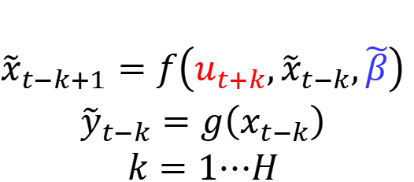
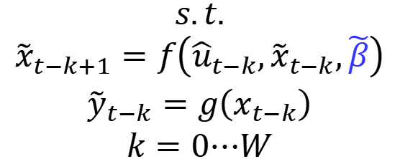
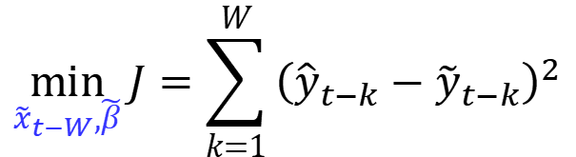


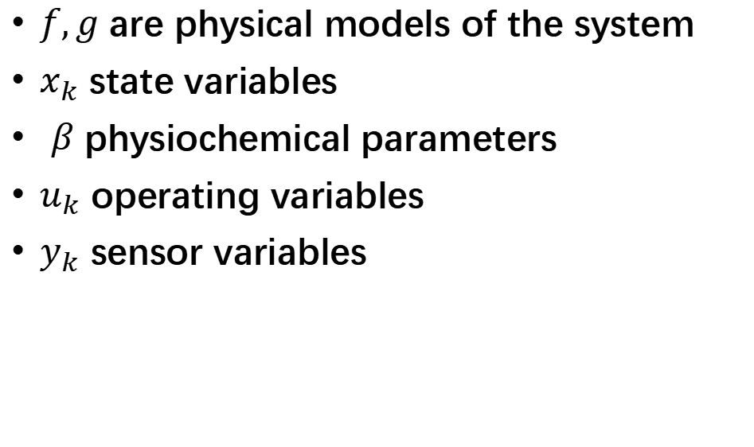
Challenges of FPM
$$\min_{{\tilde{x}}_{t−W},\tilde{β}}{J=\sum_{k=1}^{W}{{\left({\hat{y}}_{t−k}−{\tilde{y}}_{t−k}\right)}^{2}}}$$
$$\begin{matrix}s.t. \\ {\tilde{x}}_{t−k+1}=f\left({\hat{u}}_{t−k},{\tilde{x}}_{t−k},\tilde{β}\right) \\ \begin{aligned}{\tilde{y}}_{t−k}=g\left(x_{t−k}\right) \\ k=0⋯W\end{aligned}\end{matrix}$$
$$x_{k+1}=f\left(x_{k},u_{k},β\right)$$
Observer
$$y_{k}=g\left(x_{k}\right)$$
$$\begin{matrix} \\ {\tilde{x}}_{t−k+1}=f\left(u_{t+k},{\tilde{x}}_{t−k},\tilde{β}\right) \\ \begin{aligned}{\tilde{y}}_{t−k}=g\left(x_{t−k}\right) \\ k=1⋯H\end{aligned}\end{matrix}$$
$f,g$ are physical models of the system
$x_{k}$ state variables
$β$ physiochemical parameters
$u_{k}$ operating variables
$y_{k}$ sensor variables
Predictors
Since a large number of state variables cannot be measured, they must be “observed” from past data before futute predictions can be made.

Slide 4
Sequence-to-Sequence Models as DDM
Chou, C. H., Wu, H., Kang, J. L., Wong, D. S. H., Yao, Y., Chuang, Y. C., ... & Ou, J. D. Y. (2019). Physically consistent soft-sensor development using sequence-to-sequence neural networks. IEEE Transactions on Industrial Informatics, 16(4), 2829-2838.
Jiang, Z. F., Wei, X. Z., Kang, J. L., Wong, D. S. H., Yao, Y., Chuang, Y. C., Jang, S.S. & Ou, J. D. Y. (2024). Deep learning model predictive control of a high-density polyethylene reactor with a physics-guided sequence-to-sequence model with memory. Computers & Chemical Engineering, 189, 108790.
Kang, J. L., Mirzaei, S., & Yang, Z. H. (2023). Sequence-to-sequence digital twin model in chemical plants with internal rolling training algorithm. Applied Soft Computing, 146, 110608.
In the past our group has developed DDM using sequencte-to-sequence model and successfully applied to MPC of various chemical processes. Yet generative predictions beyond the decoder horizon are not good, unless a special time consuming training algorithm is used.

Slide 5
Motivation, Scope and Objective
In this work, we propose new and more efficient training method known as “autoregressive training” (AT) to enhance the generative capabilities of the sequence-to-sequence model with memory layer (StSML) and transformer model so that they can serve as digital twins of complex process.
Novel tests are propose to confirm the generative capabilities of the DDM obtained.
A propylene recovery unit (PRU) is used as the demonstration example.

Slide 6
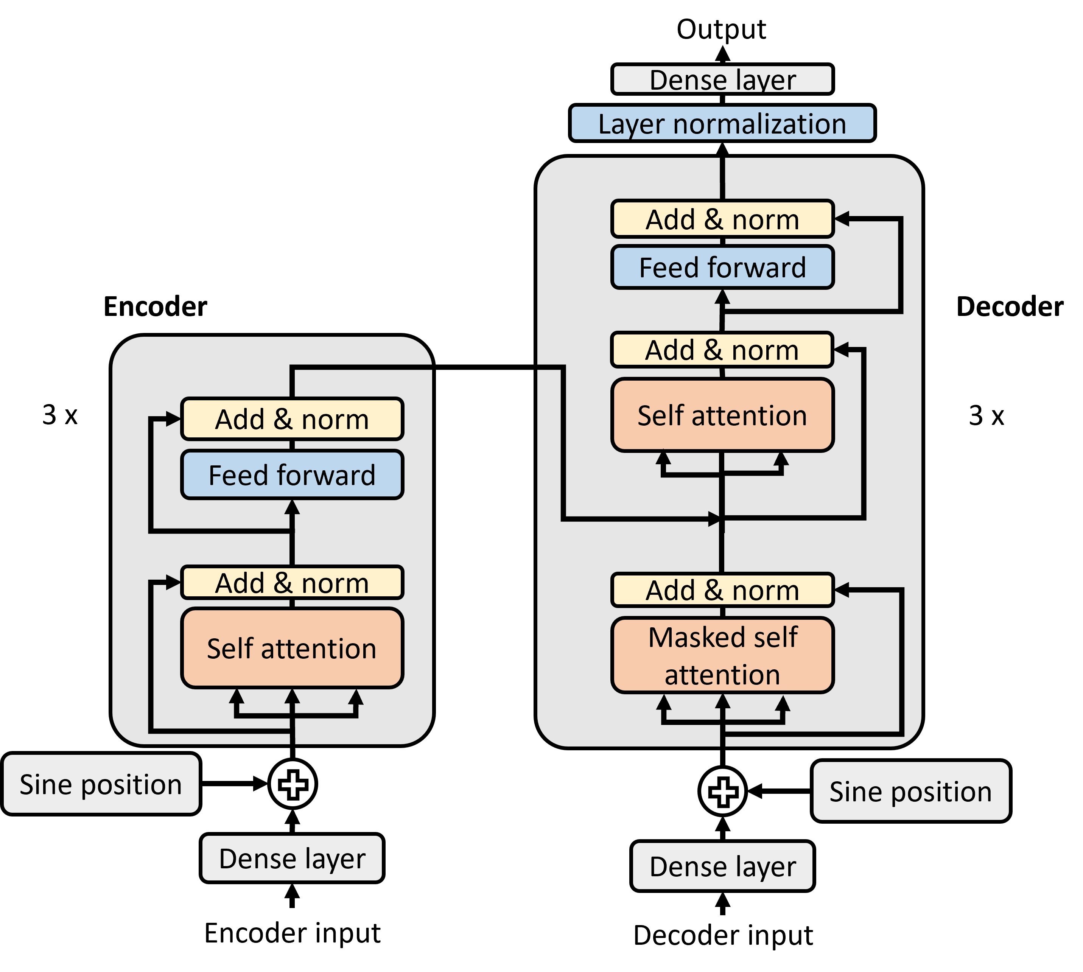
Transformer Model
Vaswani, A., Shazeer, N., Parmar, N., Uszkoreit, J., Jones, L., Gomez, A. N., ... & Polosukhin, I. (2017). Attention is all you need. Advances in neural information processing systems, 30.
The Transformer model, proposed by A. Vaswani et al. in 2017, has demonstrated outstanding performance in natural language processing tasks such as machine translation, text recognition, and speech translation.
It adopts the same encoder–decoder structure as in StS model.
Notes:
最後是google在2017年發表的transformer model，得意於他強大的自注意力演算法
Transformer model在語言翻譯，文字和語音辨識等等的任務中都頗有成效。
因其編碼器解碼器的結構，所以我們也希望transformer model也同樣可以應用在化工製程的數位孿生中。

Slide 7
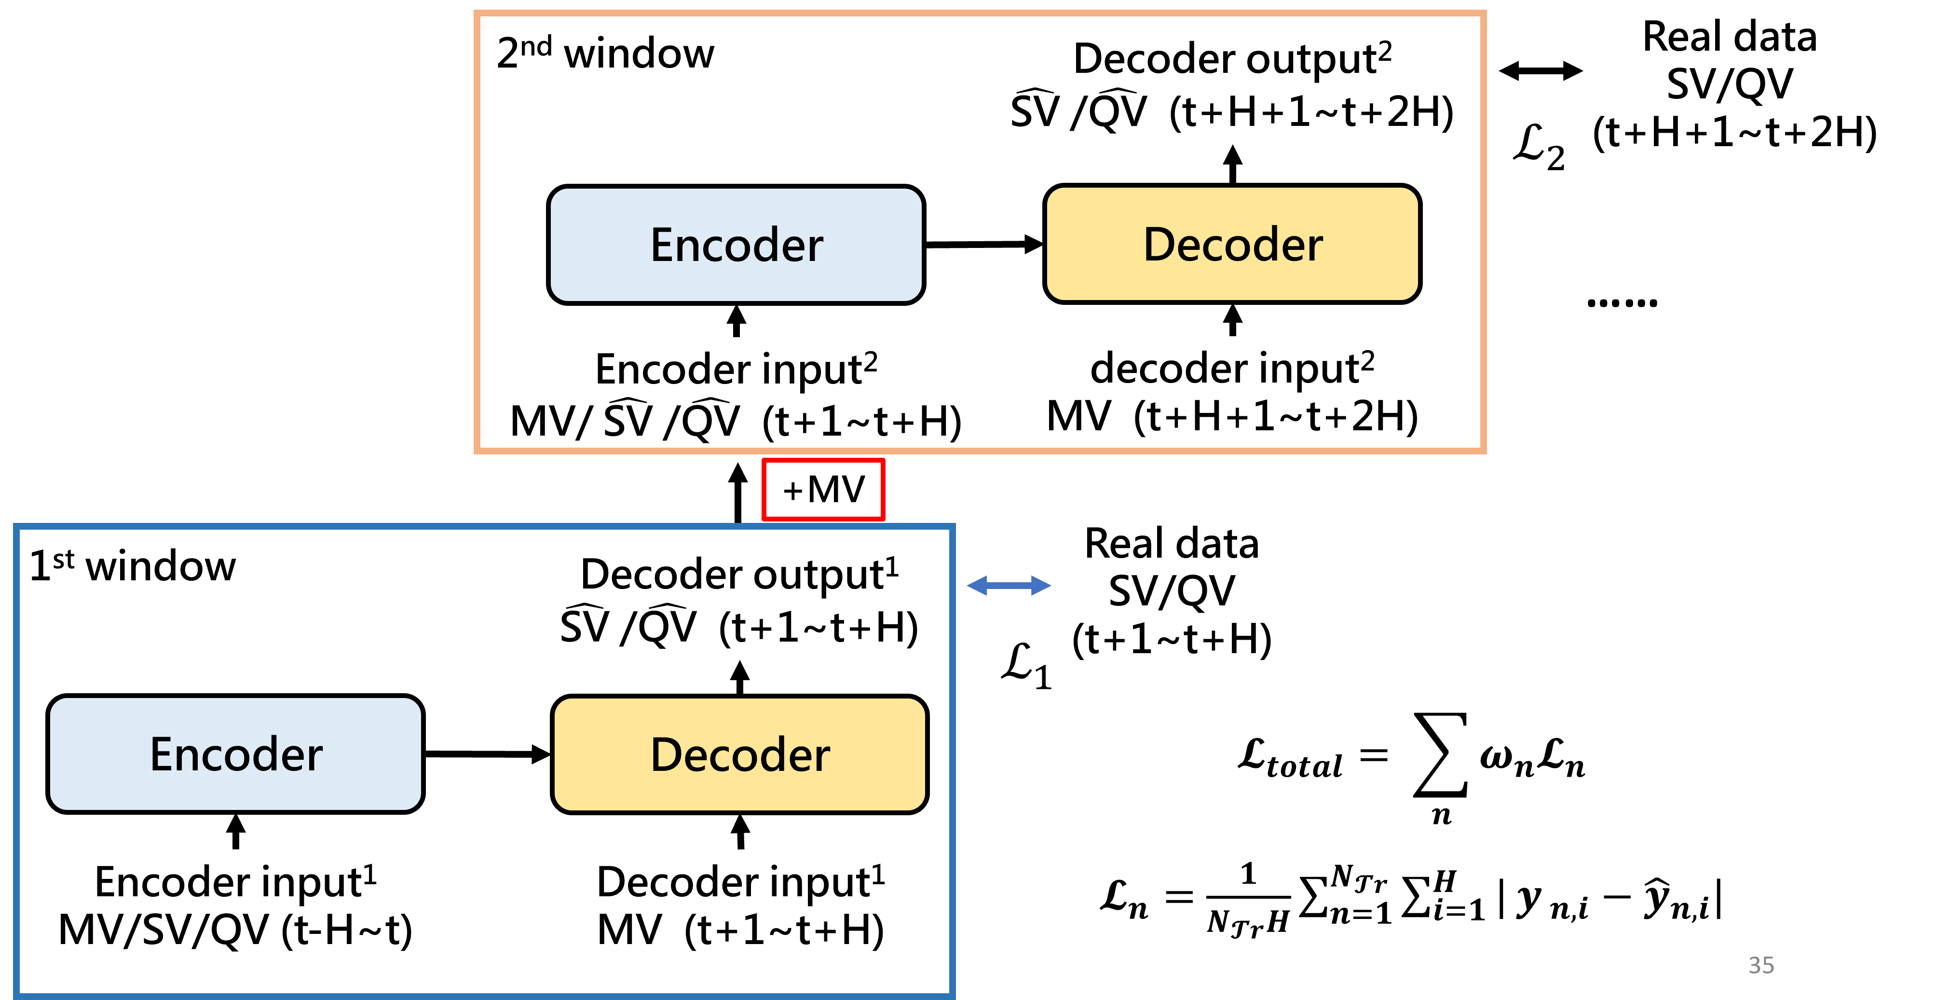
Autoregressive Prediction and Training
The concept of autoregressive predictions and training is as follows. The decoder predictions of the first horizon is input to the encoder to generate predictions of the next horizon and the process is repeated. The predictive loss of multiple horizons is used for training

Slide 8
PRU
Closed Loop
Open Loop
A PRU process is simulated using ASPEN Dynamics, both closed loop and open loop data are generated.

Slide 9
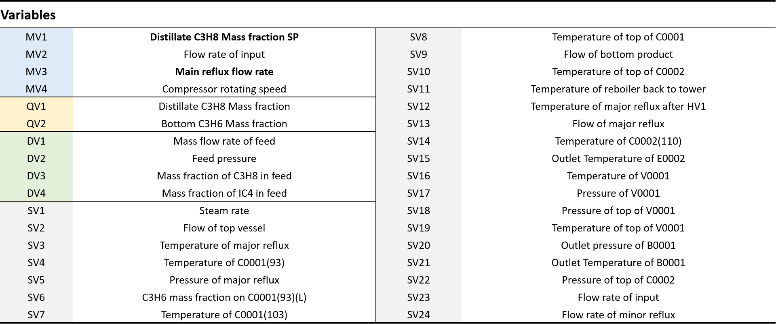
Variable Classications for Closed Loop Process
MVs and SVs in a past window are input to encoder. MV in a future horizon is the input to the decoder and SV in the horizon are output of the decoder. DVs are disturbance variables that are measured.

Slide 10
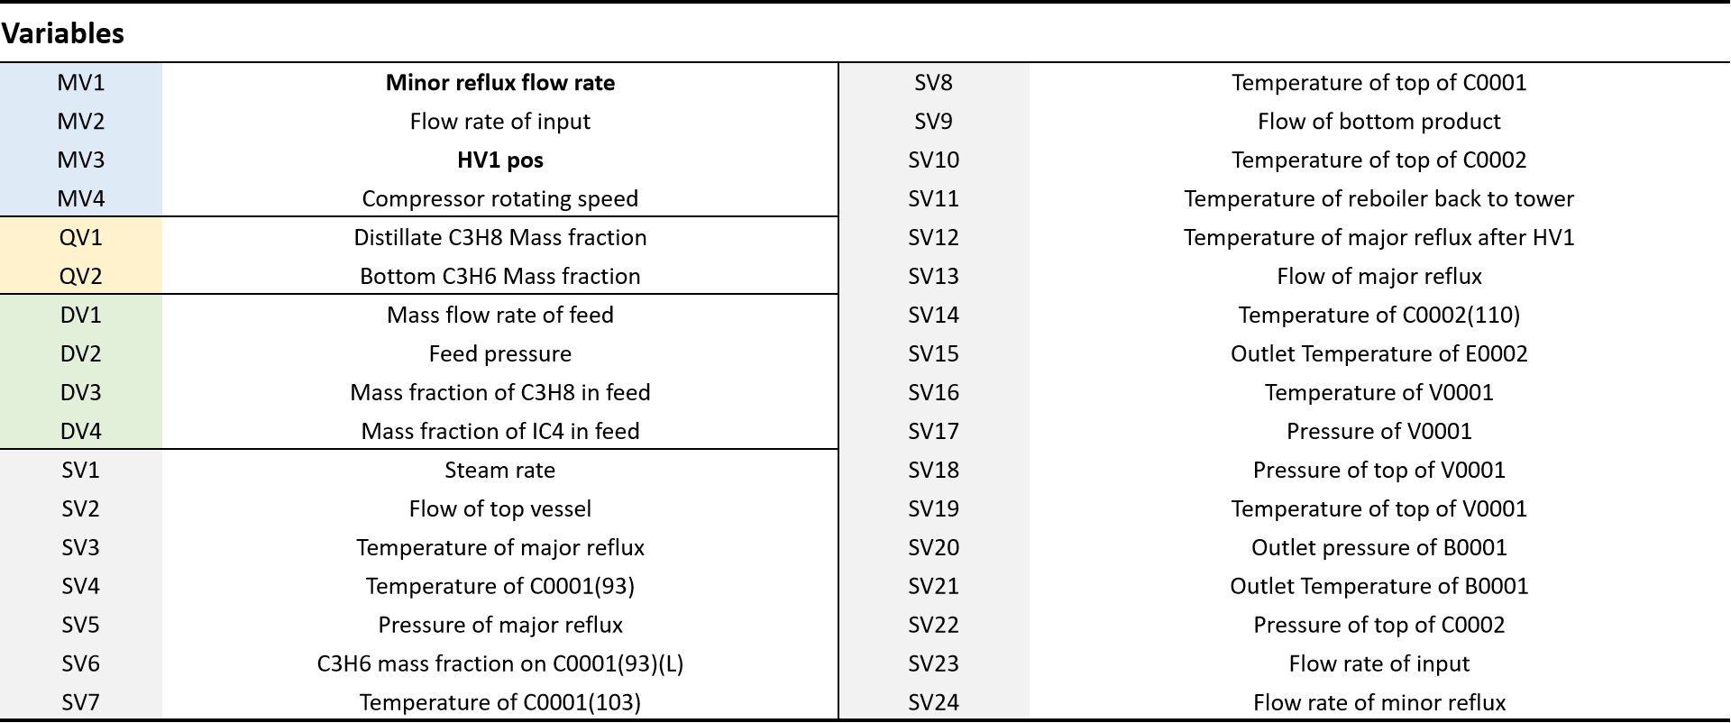
Variable Classications for Open Loop Process
MVs and SVs in a past window are input to encoder. MV in a future horizon is the input to the decoder and SV in the horizon are output of the decoder. DVs are disturbance variables that are measured.

Slide 11
Training Time for Closed Loop Data
 | StSML | StSML+AT | Transformer | Transformer+AT | StS rolling
Training time (sec) | 42166 | 12946 | 41648 | 25509 | 135996
Substantial savings in training time can be achieved compared to previous algorithms (StS Rolling).

Slide 12
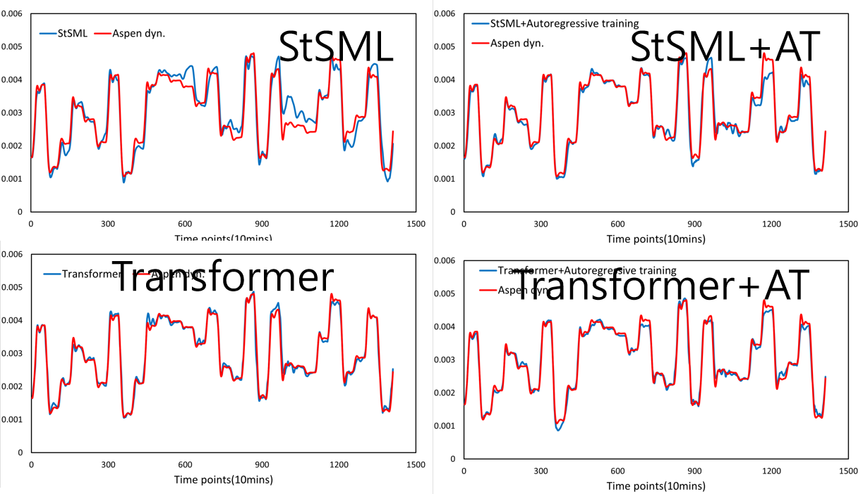
Long Term Beyond Horizon Predictions of Closed Loop Process
AT substantially enhanced the generative capacilties of StSML model.
Transformer by itself already has good beyond horizon predictions.
Notes:
這邊展示五個模型在rolling prediciton中QV的結果圖
從圖中就可以很明顯的看出序列對序列模型是完全沒有生成式預測的能力
那在記憶層序列對序列模型及Transformer模型中加入Autoregressive training後都有更加的擬和真實數據。

Slide 13
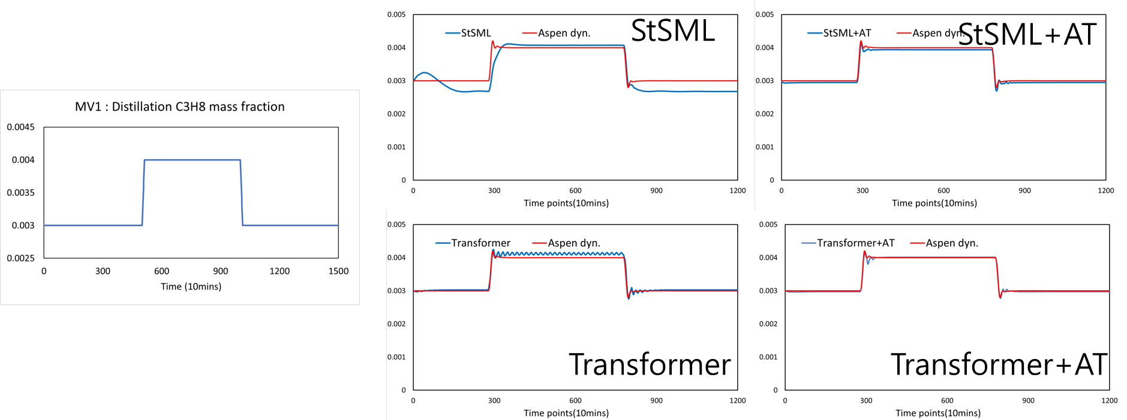
Step Test of Closed Loop Data
AT substantially enhanced the generative capacilties in step tests for both StSML and Transformer in the closed loop process.
Notes:
首先是MV1的Step change改變
左上方為MV1的改變動示意圖
右邊可以看出StS完全沒追蹤到製程的變化，接著加入記憶層後模型可以追蹤到製程上的變化，在加入autoregressive training後就更加的貼合真實數據
Transformer模型在生成式預測就做的相當不錯，在加入autoregressive training後也有蠻大的提升

Slide 14
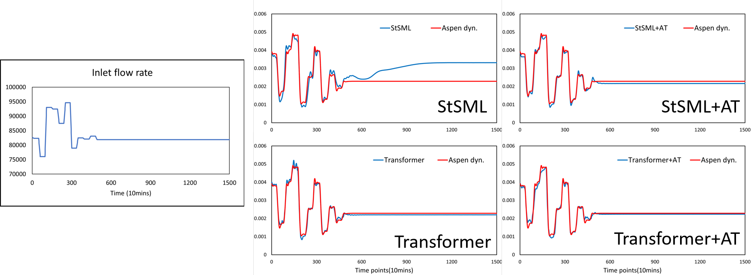
Steady State Convergence for Closed Loop Process
AT substantially enhanced the generative capacilties in steady state predictions for both StSML and Transformer in the closed loop process.

Slide 15
Open Loop Training Time
 | StS | StSML | StSML+AT | Transformer | Transformer+AT | StS rolling
Training time (sec) | 46687 | 16651 | 11248 | 28945 | 10430 | 276410
Substantial savings in training time can be achieved compared to previous algorithms (StS Rolling).

Slide 16
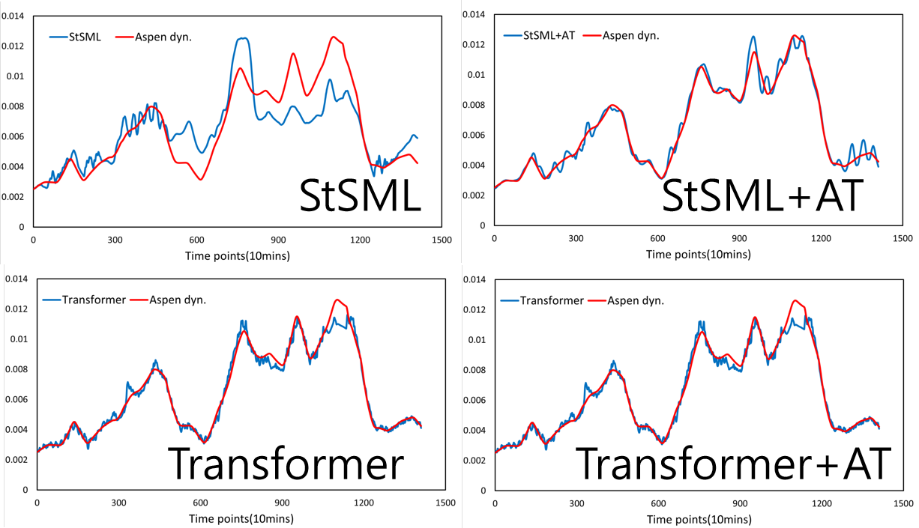
Long Term Beyond Horizon Predictions for Open Loop Process
AT substantially enhanced the generative capacilties of StSML model.
Transformer by itself already has good beyond horizon predictions.
Notes:
這邊展示五個模型在rolling prediciton中QV的結果圖
從圖中就可以很明顯的看出序列對序列模型是完全沒有生成式預測的能力
那在記憶層序列對序列模型及Transformer模型中加入Autoregressive training後都有更加的擬和真實數據。

Slide 17
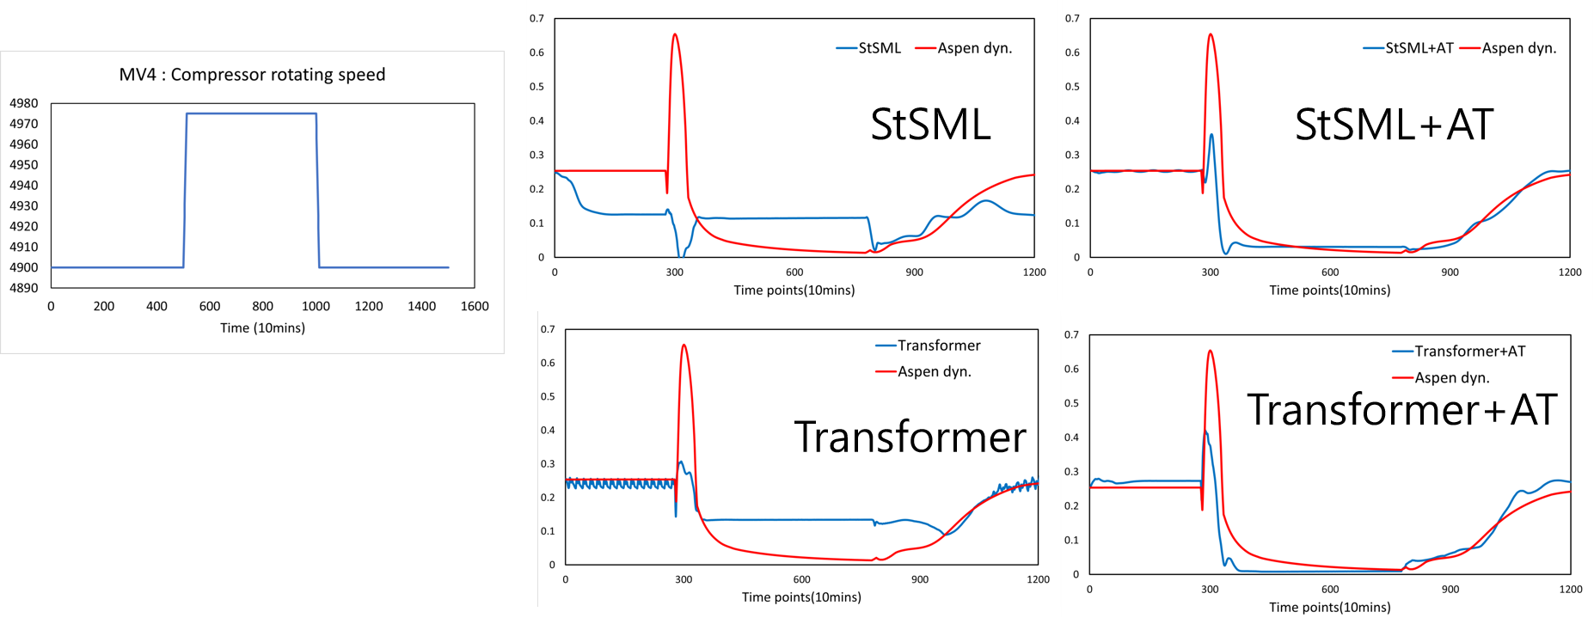
Step Tests for Closed Loop Process
AT substantially enhanced the generative capacilties of both StSML and transformer models although some error still exists. However, the general trends are consistent with FPM simulatio
Notes:
首先是MV1的Step change改變
左上方為MV1的改變動示意圖
右邊可以看出StS完全沒追蹤到製程的變化，接著加入記憶層後模型可以追蹤到製程上的變化，在加入autoregressive training後就更加的貼合真實數據
Transformer模型在生成式預測就做的相當不錯，在加入autoregressive training後也有蠻大的提升

Slide 18
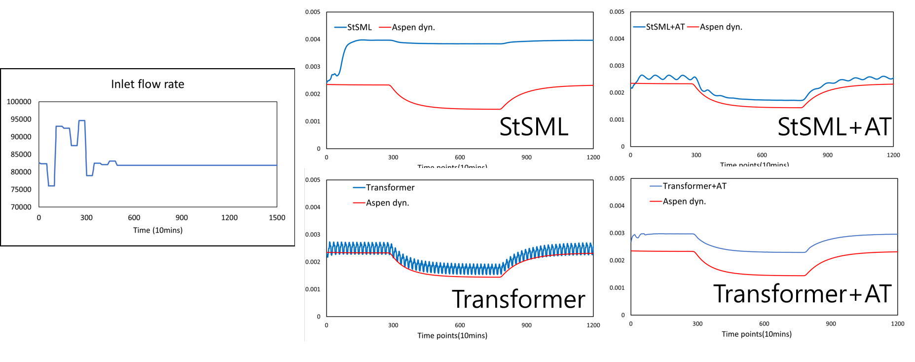
Steady State Convergence for Closed Loop Process
AT substantially enhanced the generative capacilties in steady state predictions for both StSML and Transformer in the closed loop process although some error still exists. However, the general trends are consistent with FPM simulations

Slide 19
Conclusions
Autoregressive substantially enhances the generative capabilites of the StSML and transformer model.
Various tests such as
Long term beyond horizon predictions
Step tests
Steady state convergence
were proposed as tests of the generative capabilites of DDM

